Slide 1

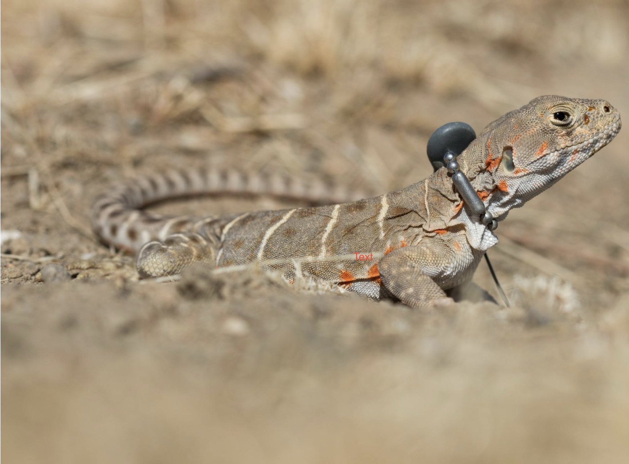
Lizard Localization Week 4 Project Update: May 6th, 2023
Vinit Saah, Joey Schnecker,
Ryan Margraf, Hassan Ahmad
Project GitHub Link
https://github.com/joey-public/WES207CapstoneProject

Slide 2
Agenda
Lab Testing and Data Result on Transmitter Behavior (Hassan)
APP design (Includes Networking updates) (Vinit)
DSP updates (Joey)
Localization simulation updates (Ryan)
Future Items
Design decision discussion

Slide 3
Basic Block Diagrams
AWG/GPSDO
Storage
2
4
Rx (USRP)
3
DSP
(Host 1)
5
6
Localization
Pure RF
PHY
(100-300
MHz
Sinusoidal
Pulses)
Host
Controller
1
Tx
Network Layer
Async TCP Sockets
UI
1
3
5
Rx (USRP)
DSP
(Host 2)
2
4
Storage
AWG/GPSDO

Slide 4
Lab Testing and Data Results - Overview
Week 3 Lab Session (Apr 29th):
Tested "prototype" budget GPSDOs to verify GPS lock and 1PPS signal output
Brainstormed synchronization methodology with 1PPS to minimize timing offset between receivers
Established real initial benchmark performance of received signal on USRP 2920 from PD-2 transmitter
Collected sample received signal data at 10, 20, 30, 40, 50, and 60 meters (limited by indoor hallway space)

Slide 5
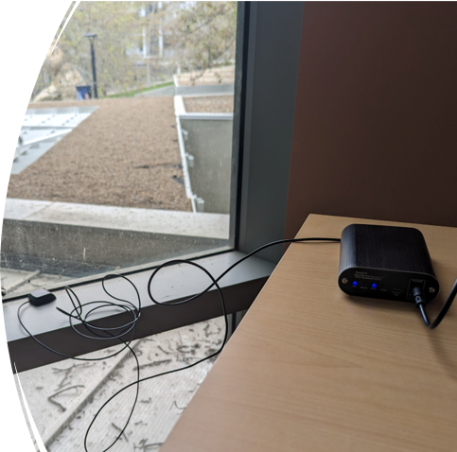
Lab Testing and Data Results - Synchronization
We were able to get GPS lock indoors with GPSDO and antenna
Observed 1PPS signal, which will be used to sync between USRP receivers
Current approach: Host controller signals for each USRP to begin receiving at next rising edge of 1PPS signal – would account for timing delays between units due to distance, socket programming, etc.
Next test:
Observe transmitter signal on two USRPs + GPSDO units placed identical distance away
Will reveal any possible timing delays under best-case scenario

Slide 6
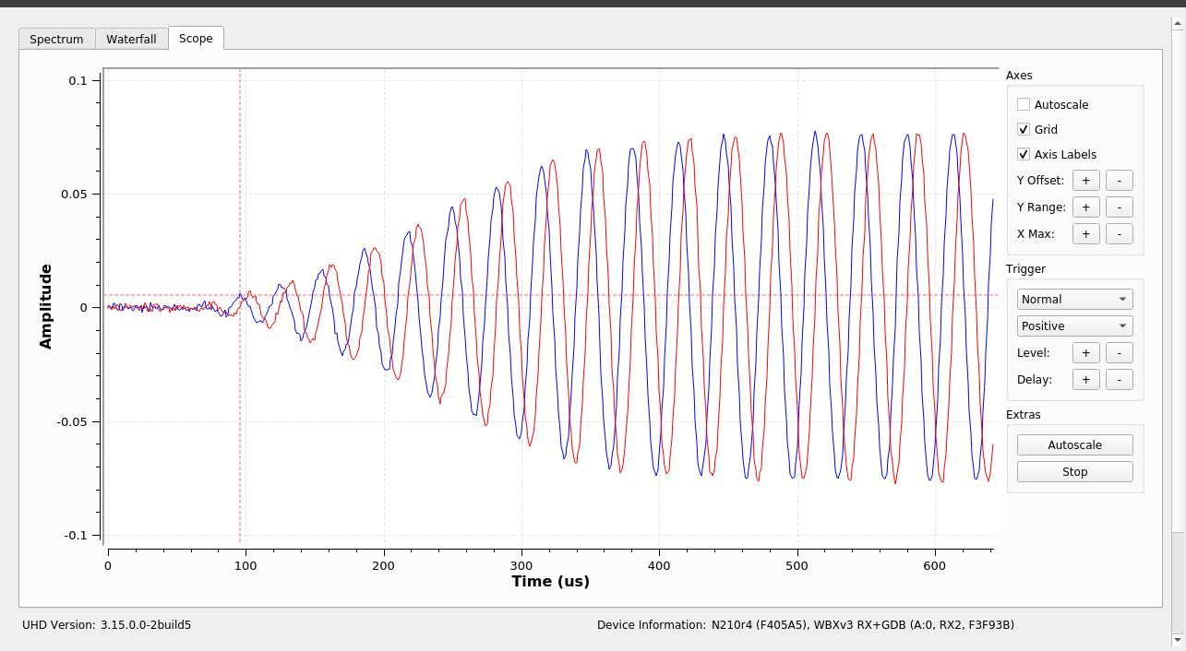
Lab Testing and Data Results - RX Benchmark Test
10 Meter Received Signal Amplitude: 0.075
Measured received signal amplitude at 10-meter steps up to 60 meters
Current setup does not show coherent 173.9 MHz signal past 30 meters

Slide 7
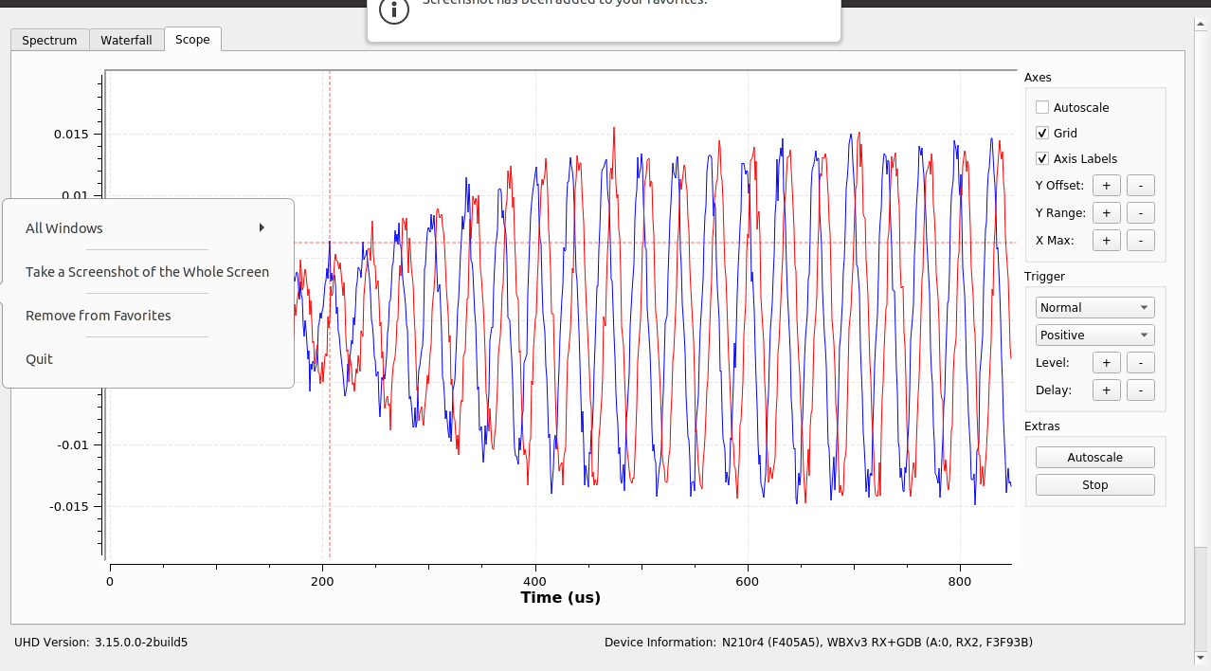
Lab Testing and Data Results - RX Benchmark Test
20 Meter Received Signal Amplitude: 0.015
Measured received signal amplitude at 10-meter steps up to 60 meters
Current setup does not show coherent 173.9 MHz signal past 30 meters

Slide 8
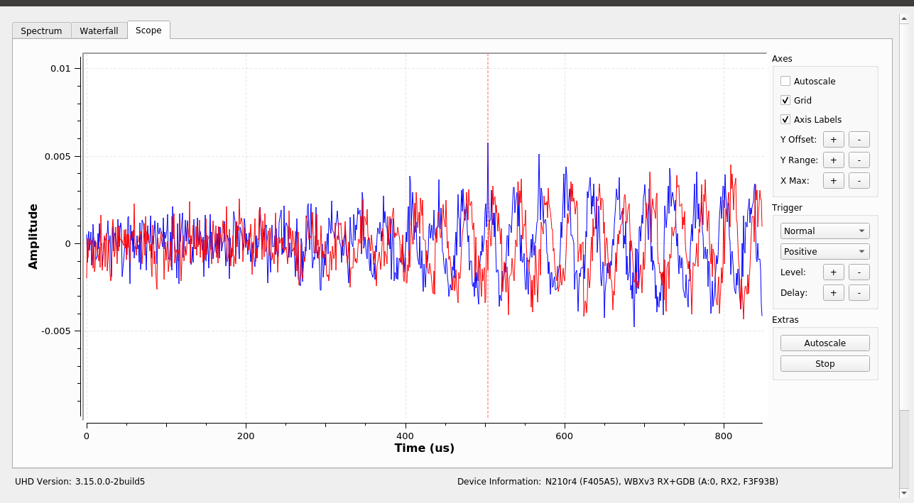
Lab Testing and Data Results - RX Benchmark Test
30 Meter Received Signal Amplitude: 0.004
Measured received signal amplitude at 10-meter steps up to 60 meters
Current setup does not show coherent 173.9 MHz signal past 30 meters

Slide 9
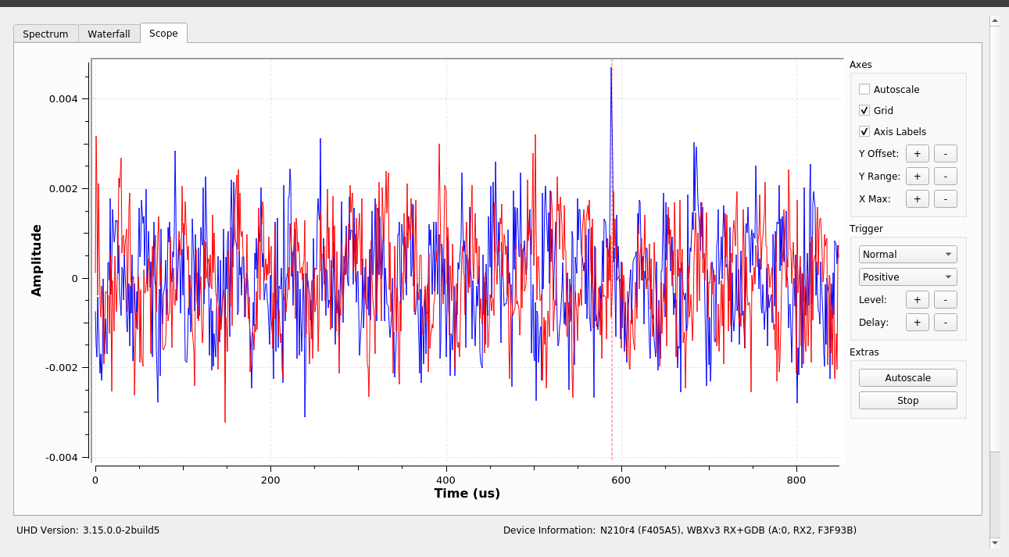
Lab Testing and Data Results - RX Benchmark Test
40 Meter Received Signal Amplitude: ?
Measured received signal amplitude at 10-meter steps up to 60 meters
Current setup does not show coherent 173.9 MHz signal past 30 meters

Slide 10
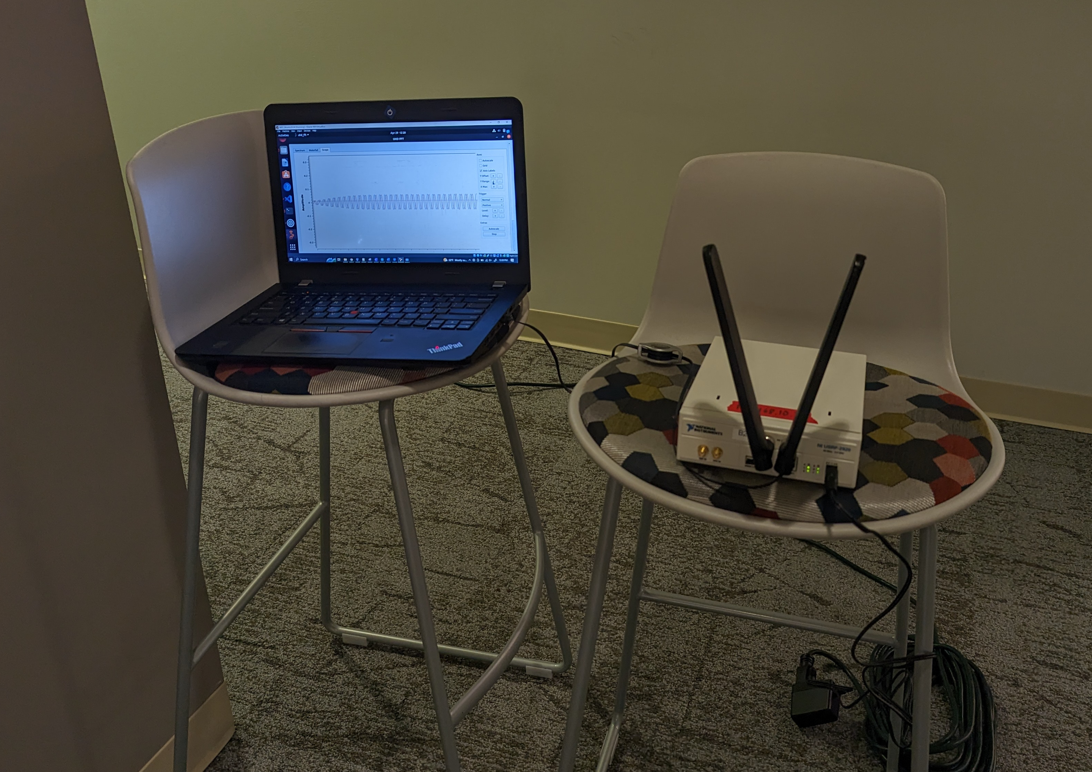
Lab Testing and Data Results - RX Benchmark Test
Next steps:
Determine appropriate signal filtering to clean up RX signal
Explore AGC for better RX gain at close vs. far distances
Could be as software algo or as built-in feature on USRP B200 equipment
USRP 2920 does not include AGC capability
Tune RX antenna length to better receive signals around 170 MHz
Used general, static-length Wi-Fi antennas for initial benchmark test.
Looking into getting adjustable-length antennas to better tune to 170 MHz range

Slide 11
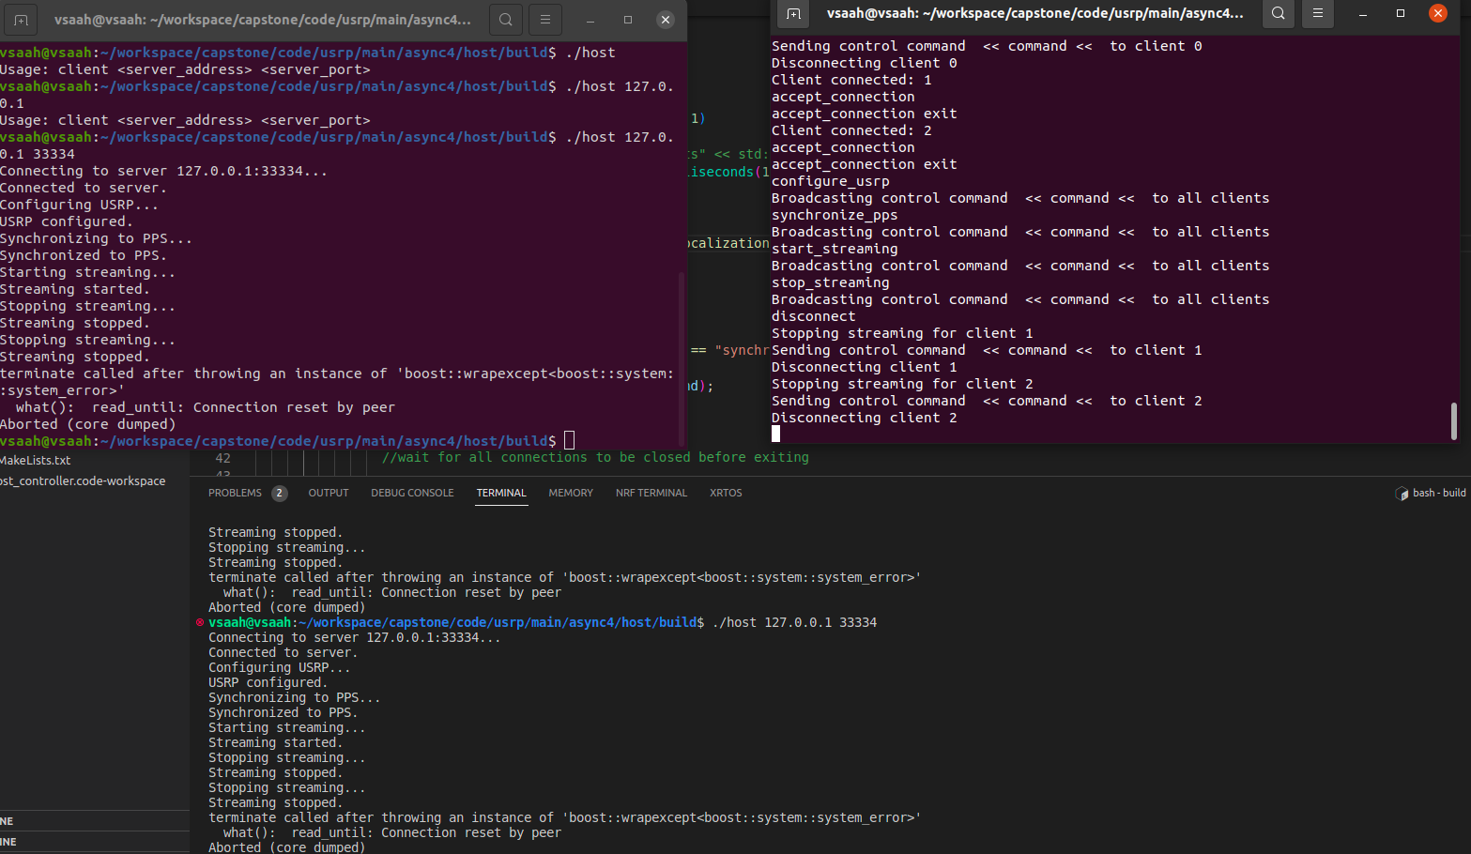
Host controller – Host(DSP) interaction
Server /Client Model.
Host Controller: Server
Host (DSP): Client
In same network (WIFI)
TCP Sockets (Async)
Host Controller: (Server) -> Learning curve
-> BOOST::ASIO:SOCKET Async accept
-> Has dedicated sockets for each host (Clients)
-> Broadcast messages to client. (Successful)
->Tested on local instances of clients.

Slide 12
TODO:
-> Test code (To collect sample together on PPS) -> Target test day Saturday (In campus).
Overall system file structure:
Utilities:
-> common.h : Packet structure. Header and Data structures.
-> Parser.h: Parse data packet, header, create header
Host Controller side:
-> Server.h: Server code, using Parser.h
-> Localization.h: provides interface to parse the information.
-> HostControllerApp.h: Uses Server.h, Localization.h
Host Side:
-> Client.h: Networking with server
-> DSP.h: Performs all DSP on USRP
-> HostApp.h: Controlls Host side code.

Slide 13
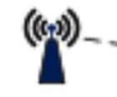
HOST- USRP Interaction
Storage
AWG/GPSDO
Rx (USRP)
DSP
(Host 1)
Tx

Slide 14
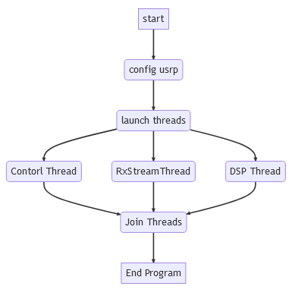
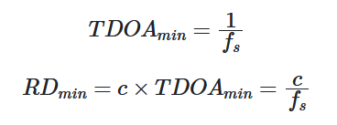
Signal Processing Update
DSP Code Progress:
Setup GitHub repo for code source control
Designed Basic logic/flowchart for all parts of DSP code
Created source code files and header for USRP initializations and Rx streaming
Separating these into separate files allows them to be stand alone and portable
First attempt used OOP, but refactored to functional and achieved same results with less and easier to understand code
Started Benchmarking actual rx streaming rate
Problem -> Having issues streaming data at rx_rates > 10 Mhz!
Sample Rate Directly Effect Localization Accuracy
10Mhz -> 100ns min TDOA
10Mhz -> 30-meter RD (BAD!)
Host Application Main Flowchart
RX_ID
RX_GPS_LOC
RX_TOA_EST
Raw_RX_Data_Stream (Maybe?)
Proposed Data Packet to send from Host -> Host Controller

Slide 15
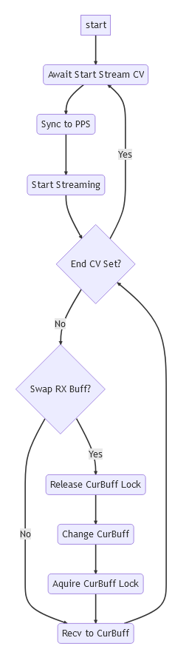
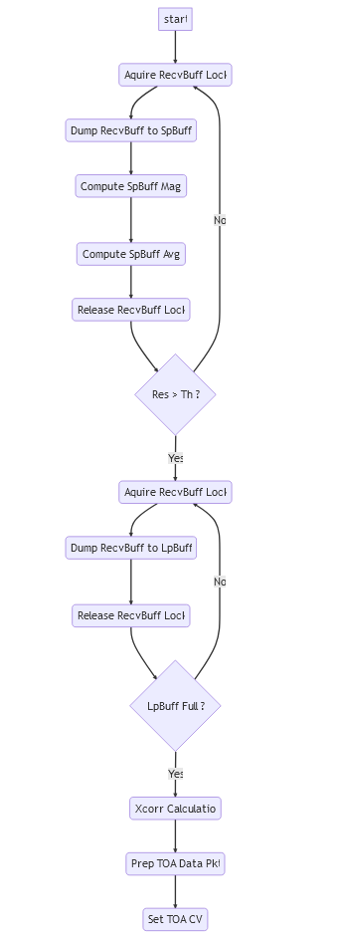
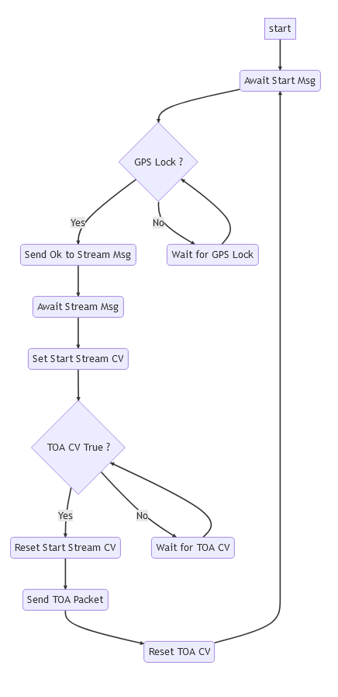
Signal Processing Flowcharts
GitHub Source
Main Application
Control Thread
RX Stream Thread
DSP Thread

Slide 16
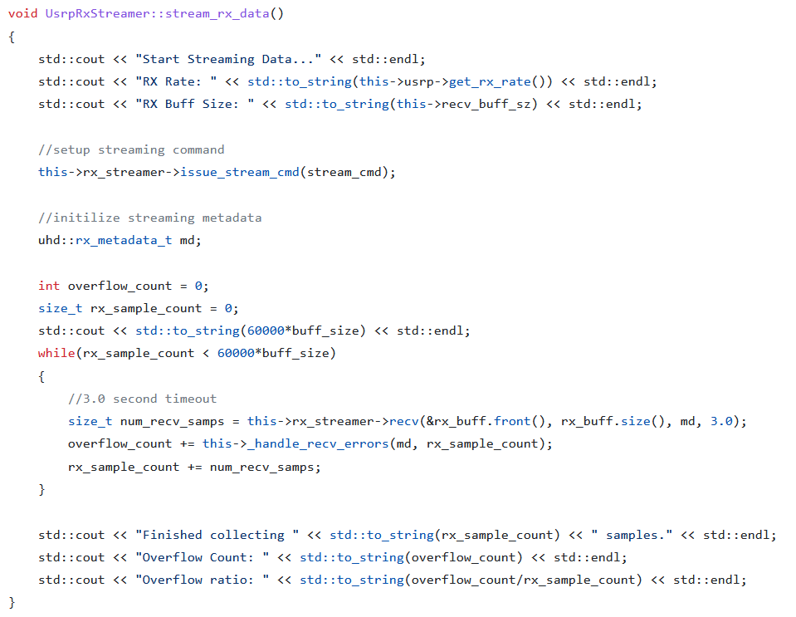
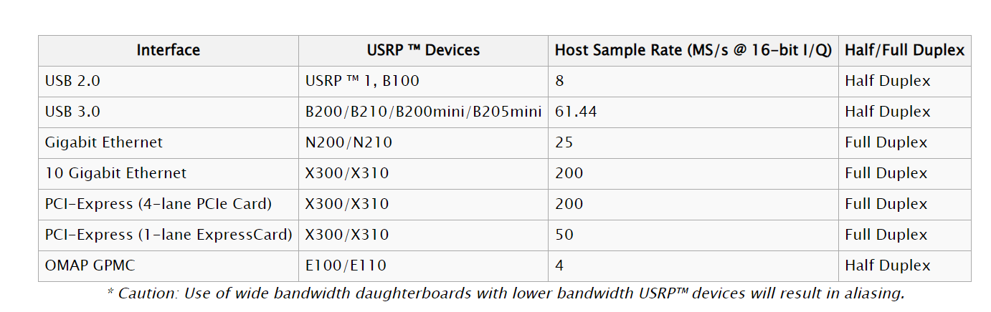
RX Streaming Rate
While loop is where data streaming occurs.
Simplest streaming code you can have
Get recv packet
Handle recv errors
Increment counter
This code was used to benchmark the max rx rate we could hope to achieve.
Actual Code we planned to have some small logic that alternates saving the recv packet into one of 2 buffers.
Then the processing thread can process one buffer while the streaming thread fills the other
App note on USRP BW and Sample Rates
B200 should support max of 61 Mhz over USB3.0
We should be able to get up to 25 Mhz with our current USRPs
FPGA processing with RFNoC might offer much faster streaming rates, but UHD libs only support RFNoC for 300 series USRPs and above.

Slide 17
Signal Processing: Next Two Weeks
Finish Refactoring Streaming code to be simpler (Functional vs OOP)
Also using pointers in the recv() to fill larger buffers without copying data between recv() packets
Try benchmark Streaming code on Native Linux Laptop
Might be my usb->ethernet that is limiting the RX-stream speed
Might be the virtual machine networking that is limiting the RX-stream speed
Still don’t expect > 25 Mhz over gigabit ethernet based on app note.
Move on to implementing other code blocks assuming we will eventually be able to improve RX-streaming speed down the line
For example, control and processing thread logic can be implemented independently of streaming logic
May 19 Goal: Have minimal version of main host application with all 3 threads working (even if rx streaming is still slower than ideal)

Slide 18
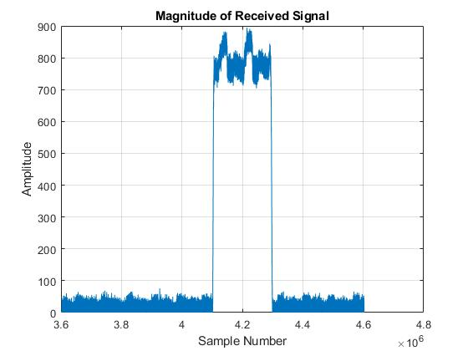
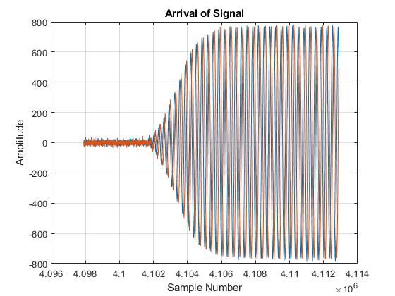
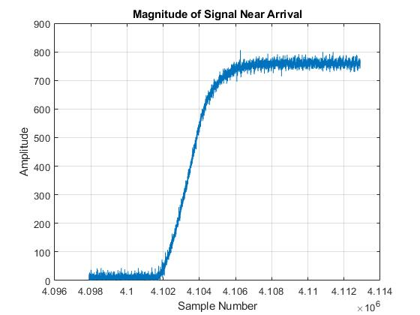
Signal Characteristics
Amplitude varies slightly during a transmission
Amplitude increases gradually near arrival

Slide 19
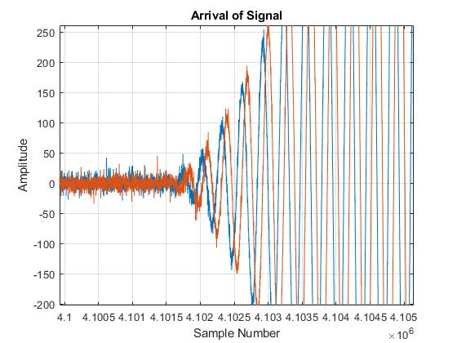
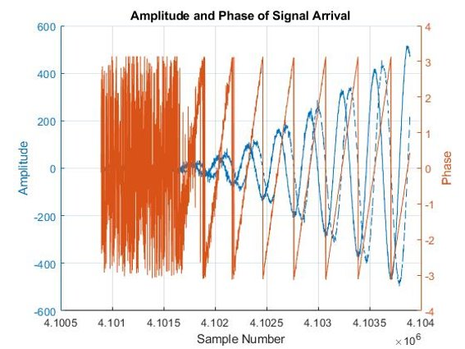
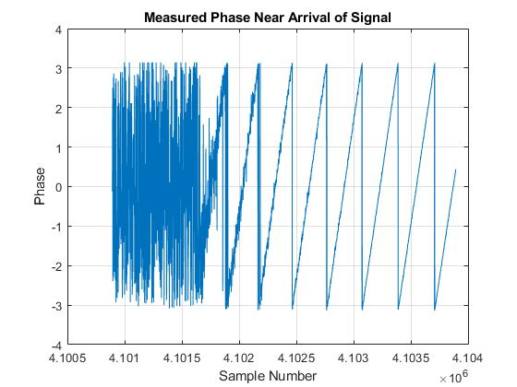
Signal Characteristics
Plots confirm this is a complex sinusoid

Slide 20
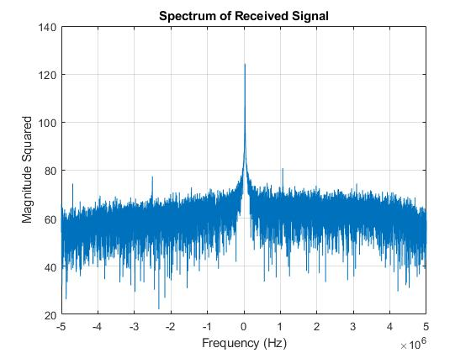
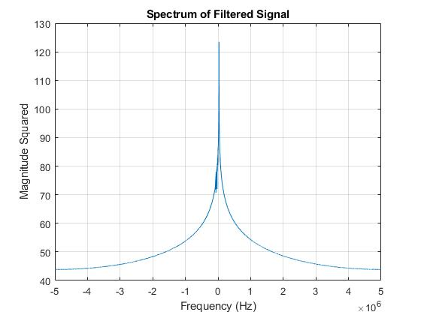
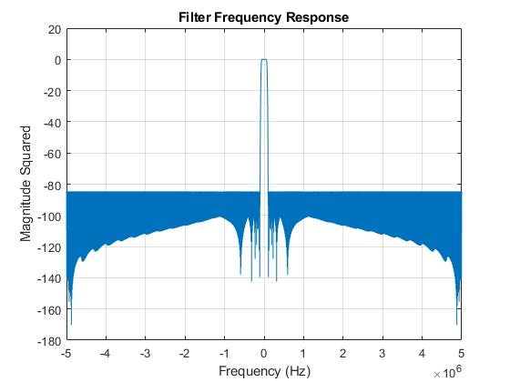
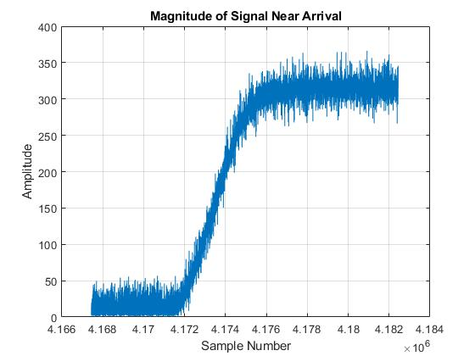
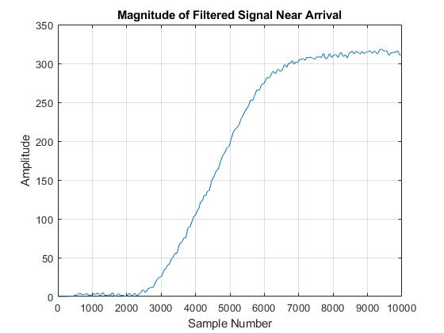
Signal Characteristics
Results shown for transmission received from 10m away, with no gain

Slide 21
Localization
Receiver Coordinates
Localization Algorithm
Estimated Location
Times of Arrival (from DSP)
Range Differences

Slide 22
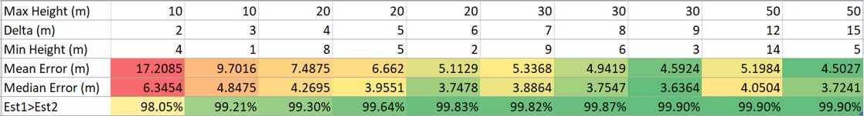
Localization
Error decreases with wider height spread of receivers and the closer one of them is to the ground
The "plus" solution of the quadratic is correct a vast majority of the time in all scenarios tested
Error measurements and 1 solution reliability of quadratic equation for
100,000 trials and 3m standard deviation of noise for range estimates

Slide 23
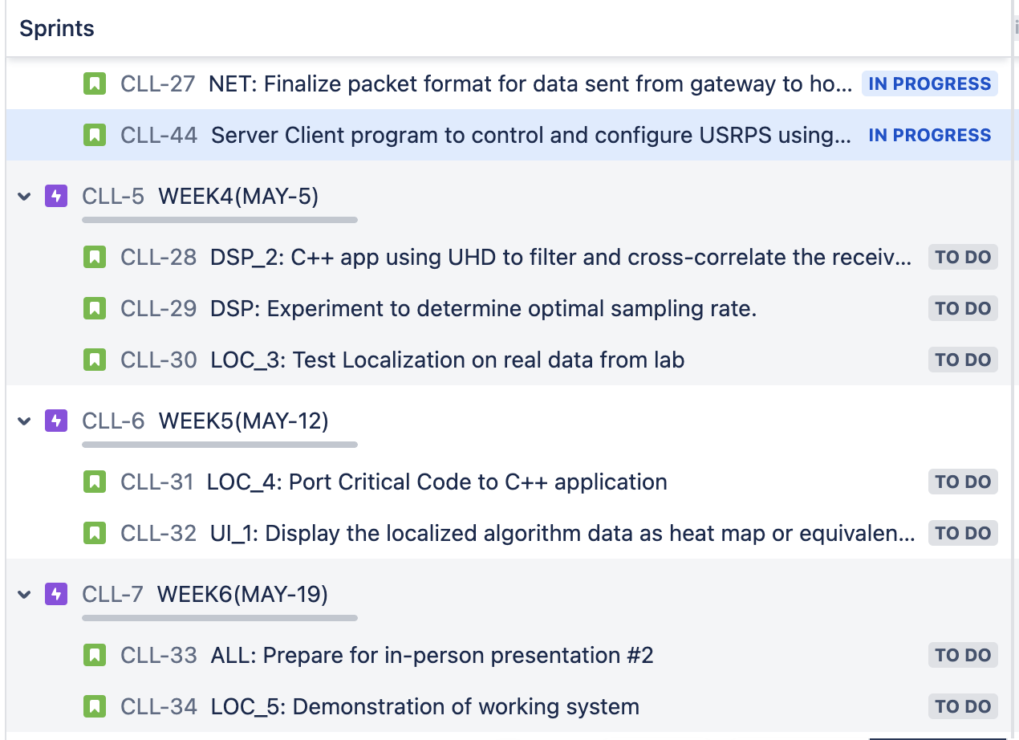
Future Tasks

Slide 24
Test Networking code to broadcast message to host to collect samples and store in the file.
Use this information for localization simulation and compare the result.

Slide 25
Points to discuss
DSP
Threshold detection: Beyond 20m not able to detect any pulses.
Host side correlation using Template signal. Detect the peak, stream Peak ID + Time stamp. Could also store them in a file (Optional if needed)
Consider sending a few ms of samples to host controller. Host controller could perform correlation between collected samples. Better match than just using template signal could provide more accurate time estimate
Could make Host Controller overloaded.

